Slide 1
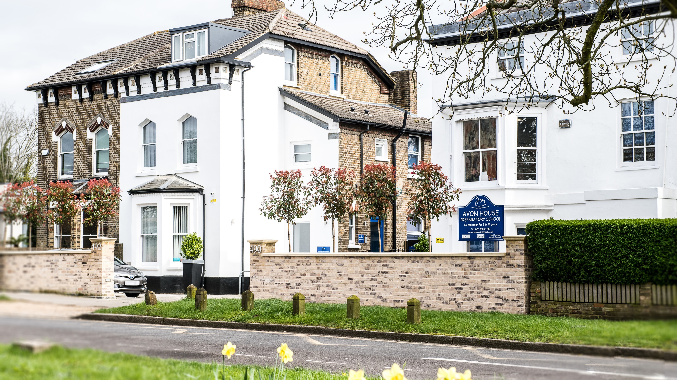
Sex Education at Avon House Preparatory School
1

Slide 2
Sharing of Rationale and Information
Sharing of resources
Alleviating concerns and answer questions
2

Slide 3
Definitions
RPS
(a blend of..)
PSHEE RE
(Personal, Social, Health, (Religious Education)
and Economic Education)
RHSE
(Relationships, Health and Sex Education)
3

Slide 4
Definitions explained
RHSE
(Relationships, Health and Sex Education)
Relationships Education = “The focus in primary school should be on teaching the fundamental building blocks and characteristics of positive relationships, with particular reference to friendships, family relationships, and relationships with other children and with adults” (DfE)
4

Slide 5
Definitions explained
RHSE
(Relationships, Health and Sex Education)
Health Education = “The aim of teaching pupils about physical health and mental wellbeing is to give them the information that they need to make good decisions about their own health and wellbeing. It should enable them to recognise what is normal and what is an issue in themselves and others and, when issues arise, know how to seek support as early as possible from appropriate sources.” (DfE)
5

Slide 6
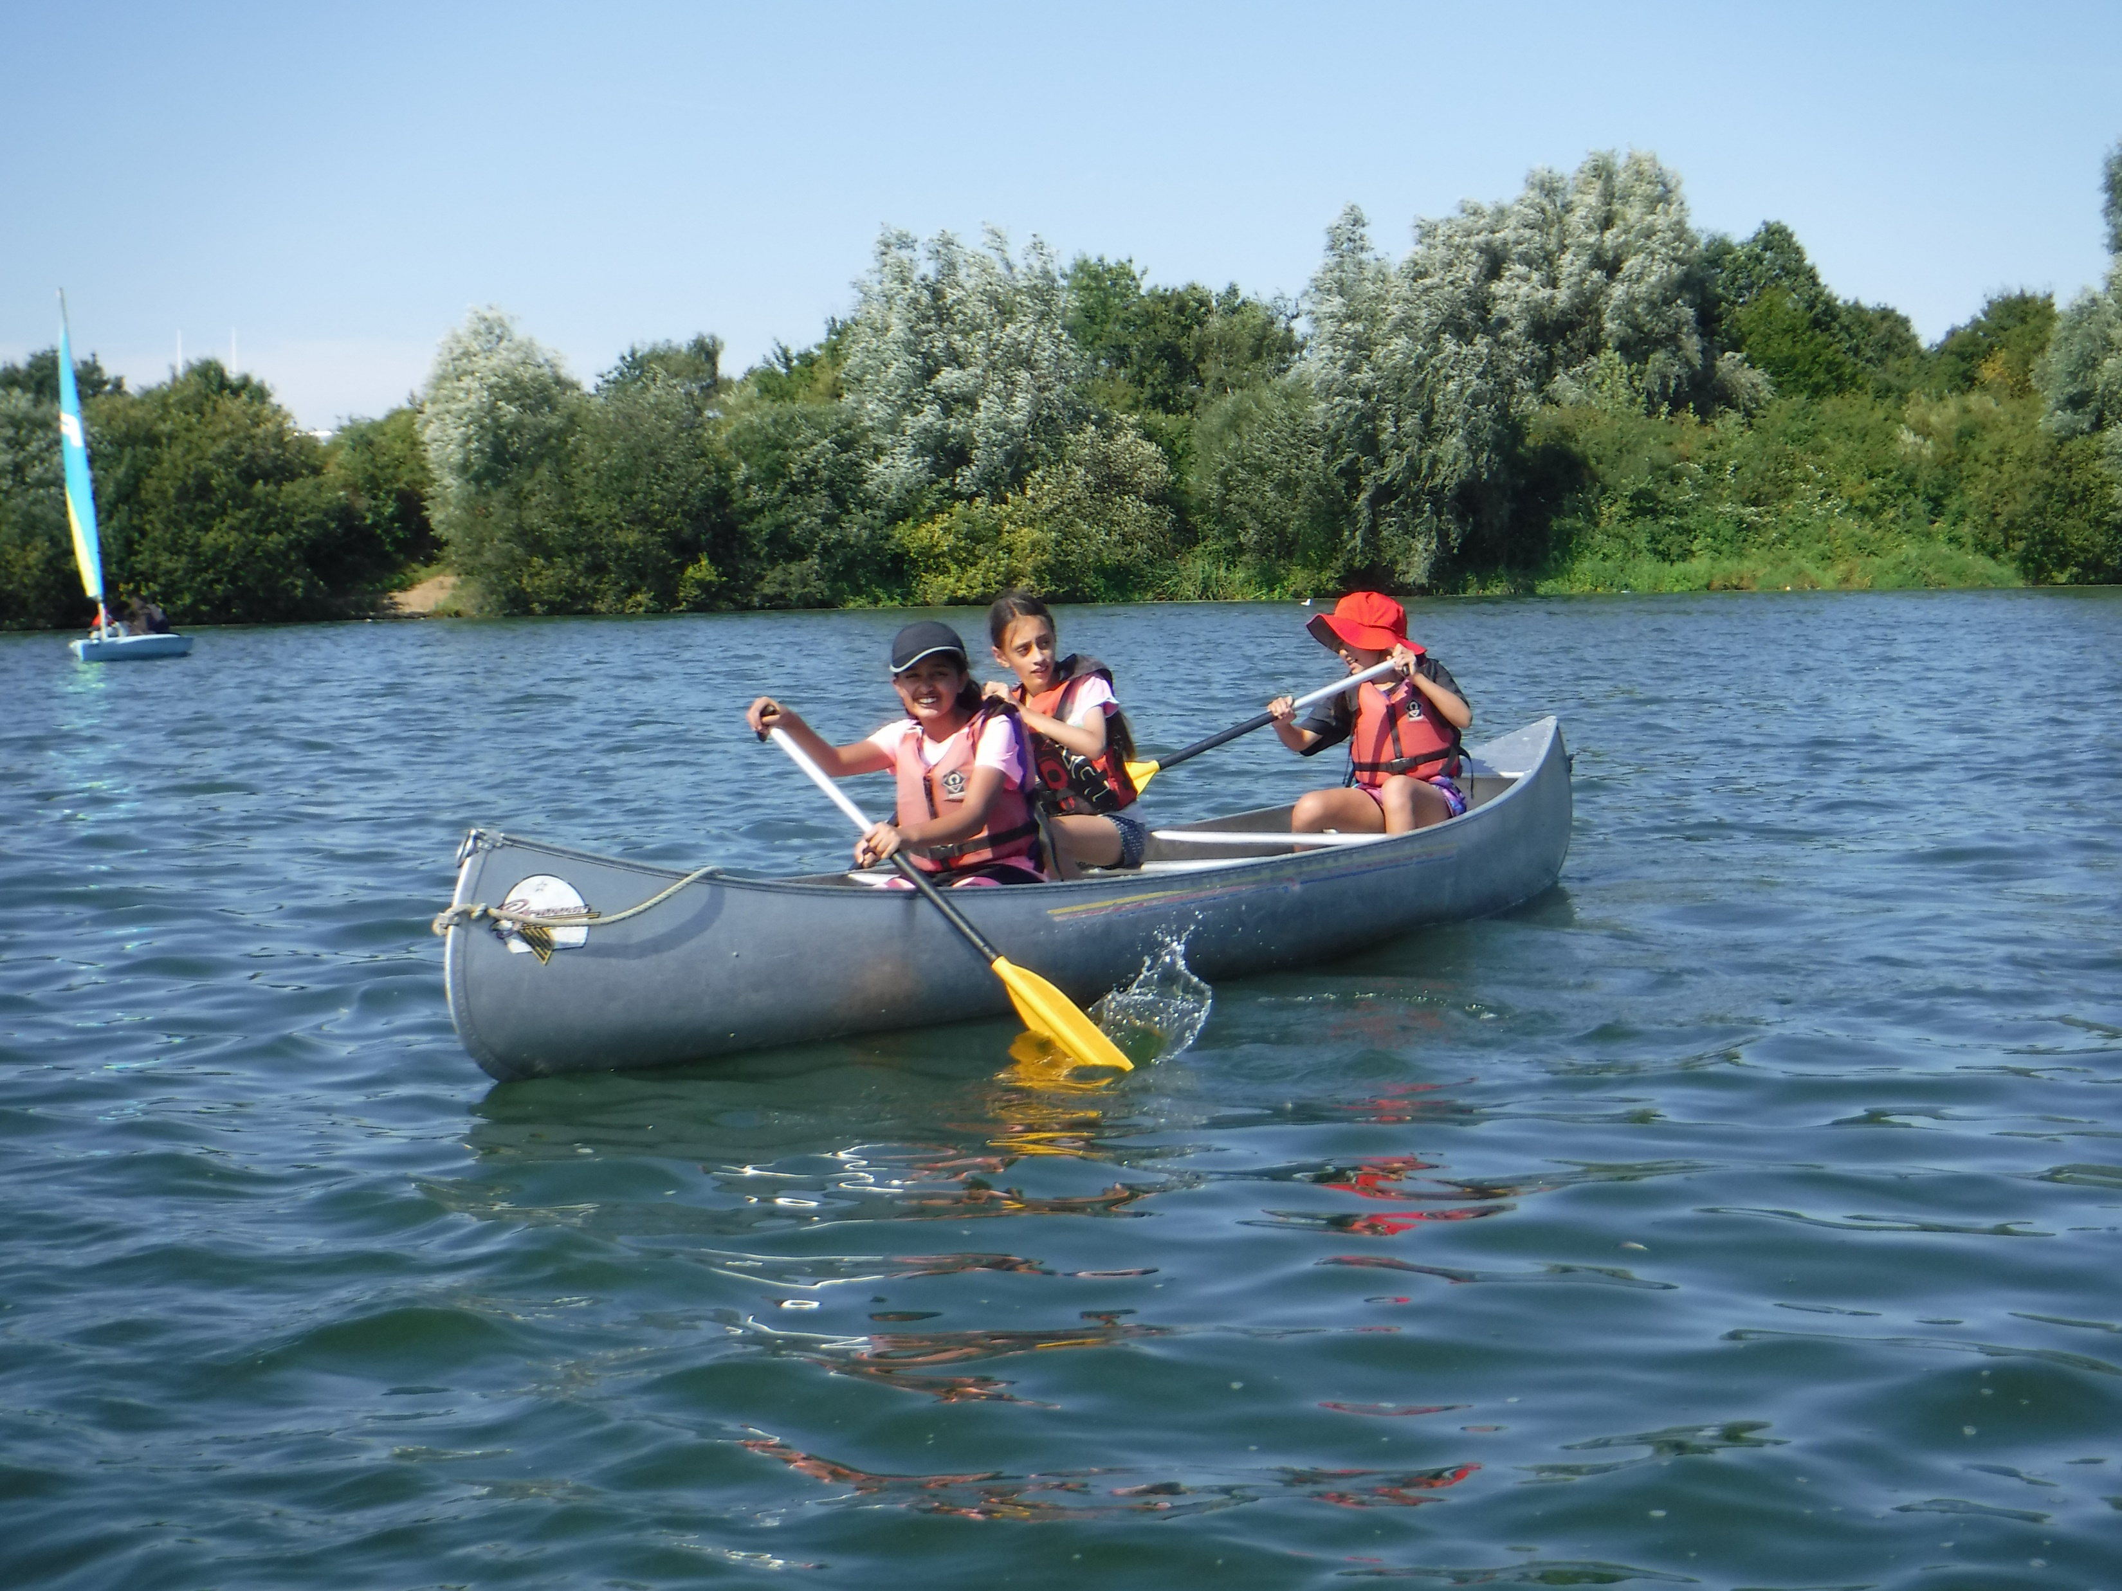
What is statutory in RHSE and what is not?
Statutory content
The Changing Adolescent Body – part of the science curriculum and also falls under Health Education
Not statutory but recommended
How a baby is made and born
6

Slide 7
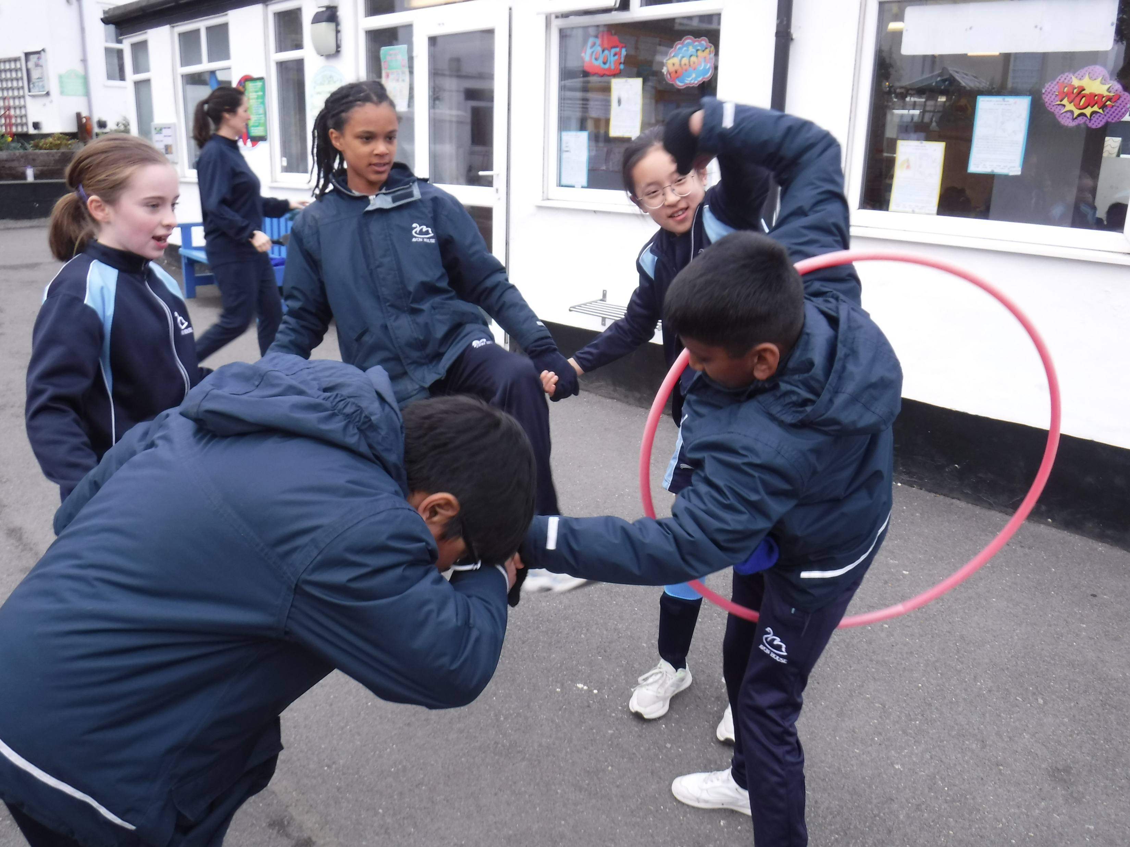
Background to statutory content decisions
Data from a report written in 2016:
‘Sexual harassment and sexual violence in schools’
More than 1 in 5 children in KS1 and KS2 reported to have had experience of jokes/banter or harassment of a sexual nature
Ofsted report in June 2021:
Children expressed concern that Sex Education at secondary school was too little too late as they “felt ill equipped to navigate the reality of their lives”
7

Slide 8
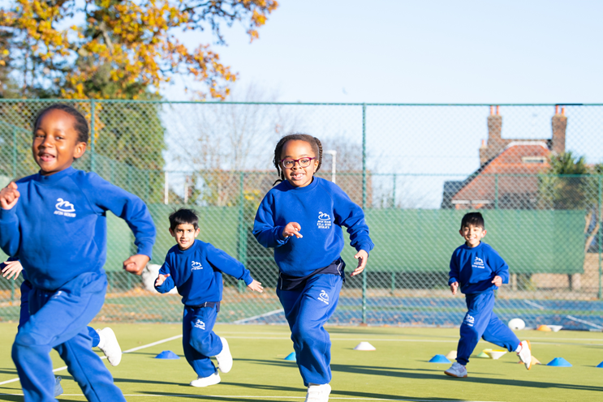
Your children’s FIRSTS!
How many ‘firsts’ will your children experience over the next 5-10 years?
How can we as adults help them to manage and deal with these new experiences whilst they keep themselves happy, safe and well…..?
8

Slide 9
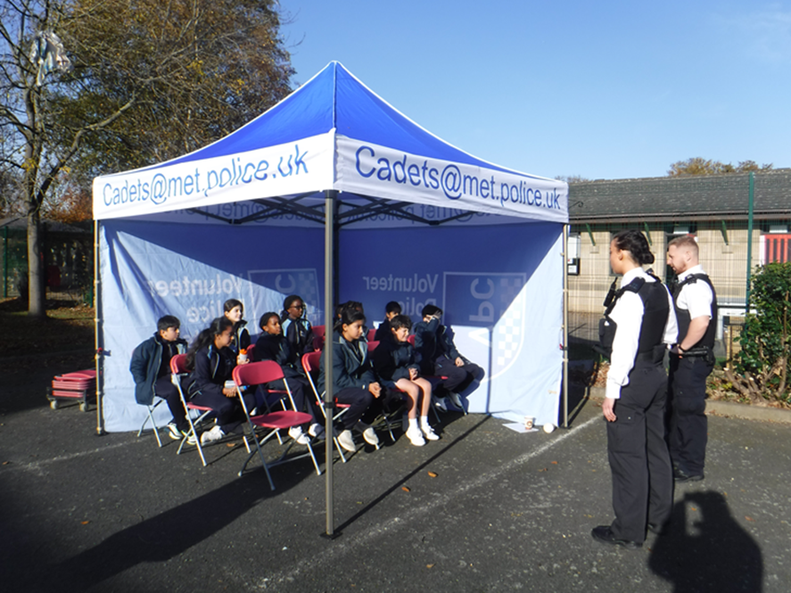
Rationale behind Sex Education to UKS2 at Avon House
Good Mental Health and Wellbeing Better Attainment and Achievement
The aim at Avon House is to help children to make sense of themselves, their bodies and the world around them so that they are informed and make wise choices.
9

Slide 10
Rationale behind Sex Education to UKS2 at Avon House
Good Mental Health and Wellbeing Better Attainment and Achievement
Good sex education, rather than encouraging children to have sex earlier, is proven to assist with:
Abuse reporting, delay in having sex for the first time, likelihood of sex being consensual, use of contraception, reduction in pregnancy and STI rates.
All of which of course fall under safeguarding of children.
10

Slide 11
Rationale behind Sex Education at Avon House
Good Mental Health and Wellbeing Better Attainment and Achievement
“All of these subjects should be set in the context of a wider whole-school approach to supporting pupils to be safe, happy and prepared for life beyond school. For example, the curriculum on relationships and on sex should complement, and be supported by, the school’s wider policies on behaviour, inclusion, respect for equality and diversity, bullying and safeguarding” (DfE)
11

Slide 12
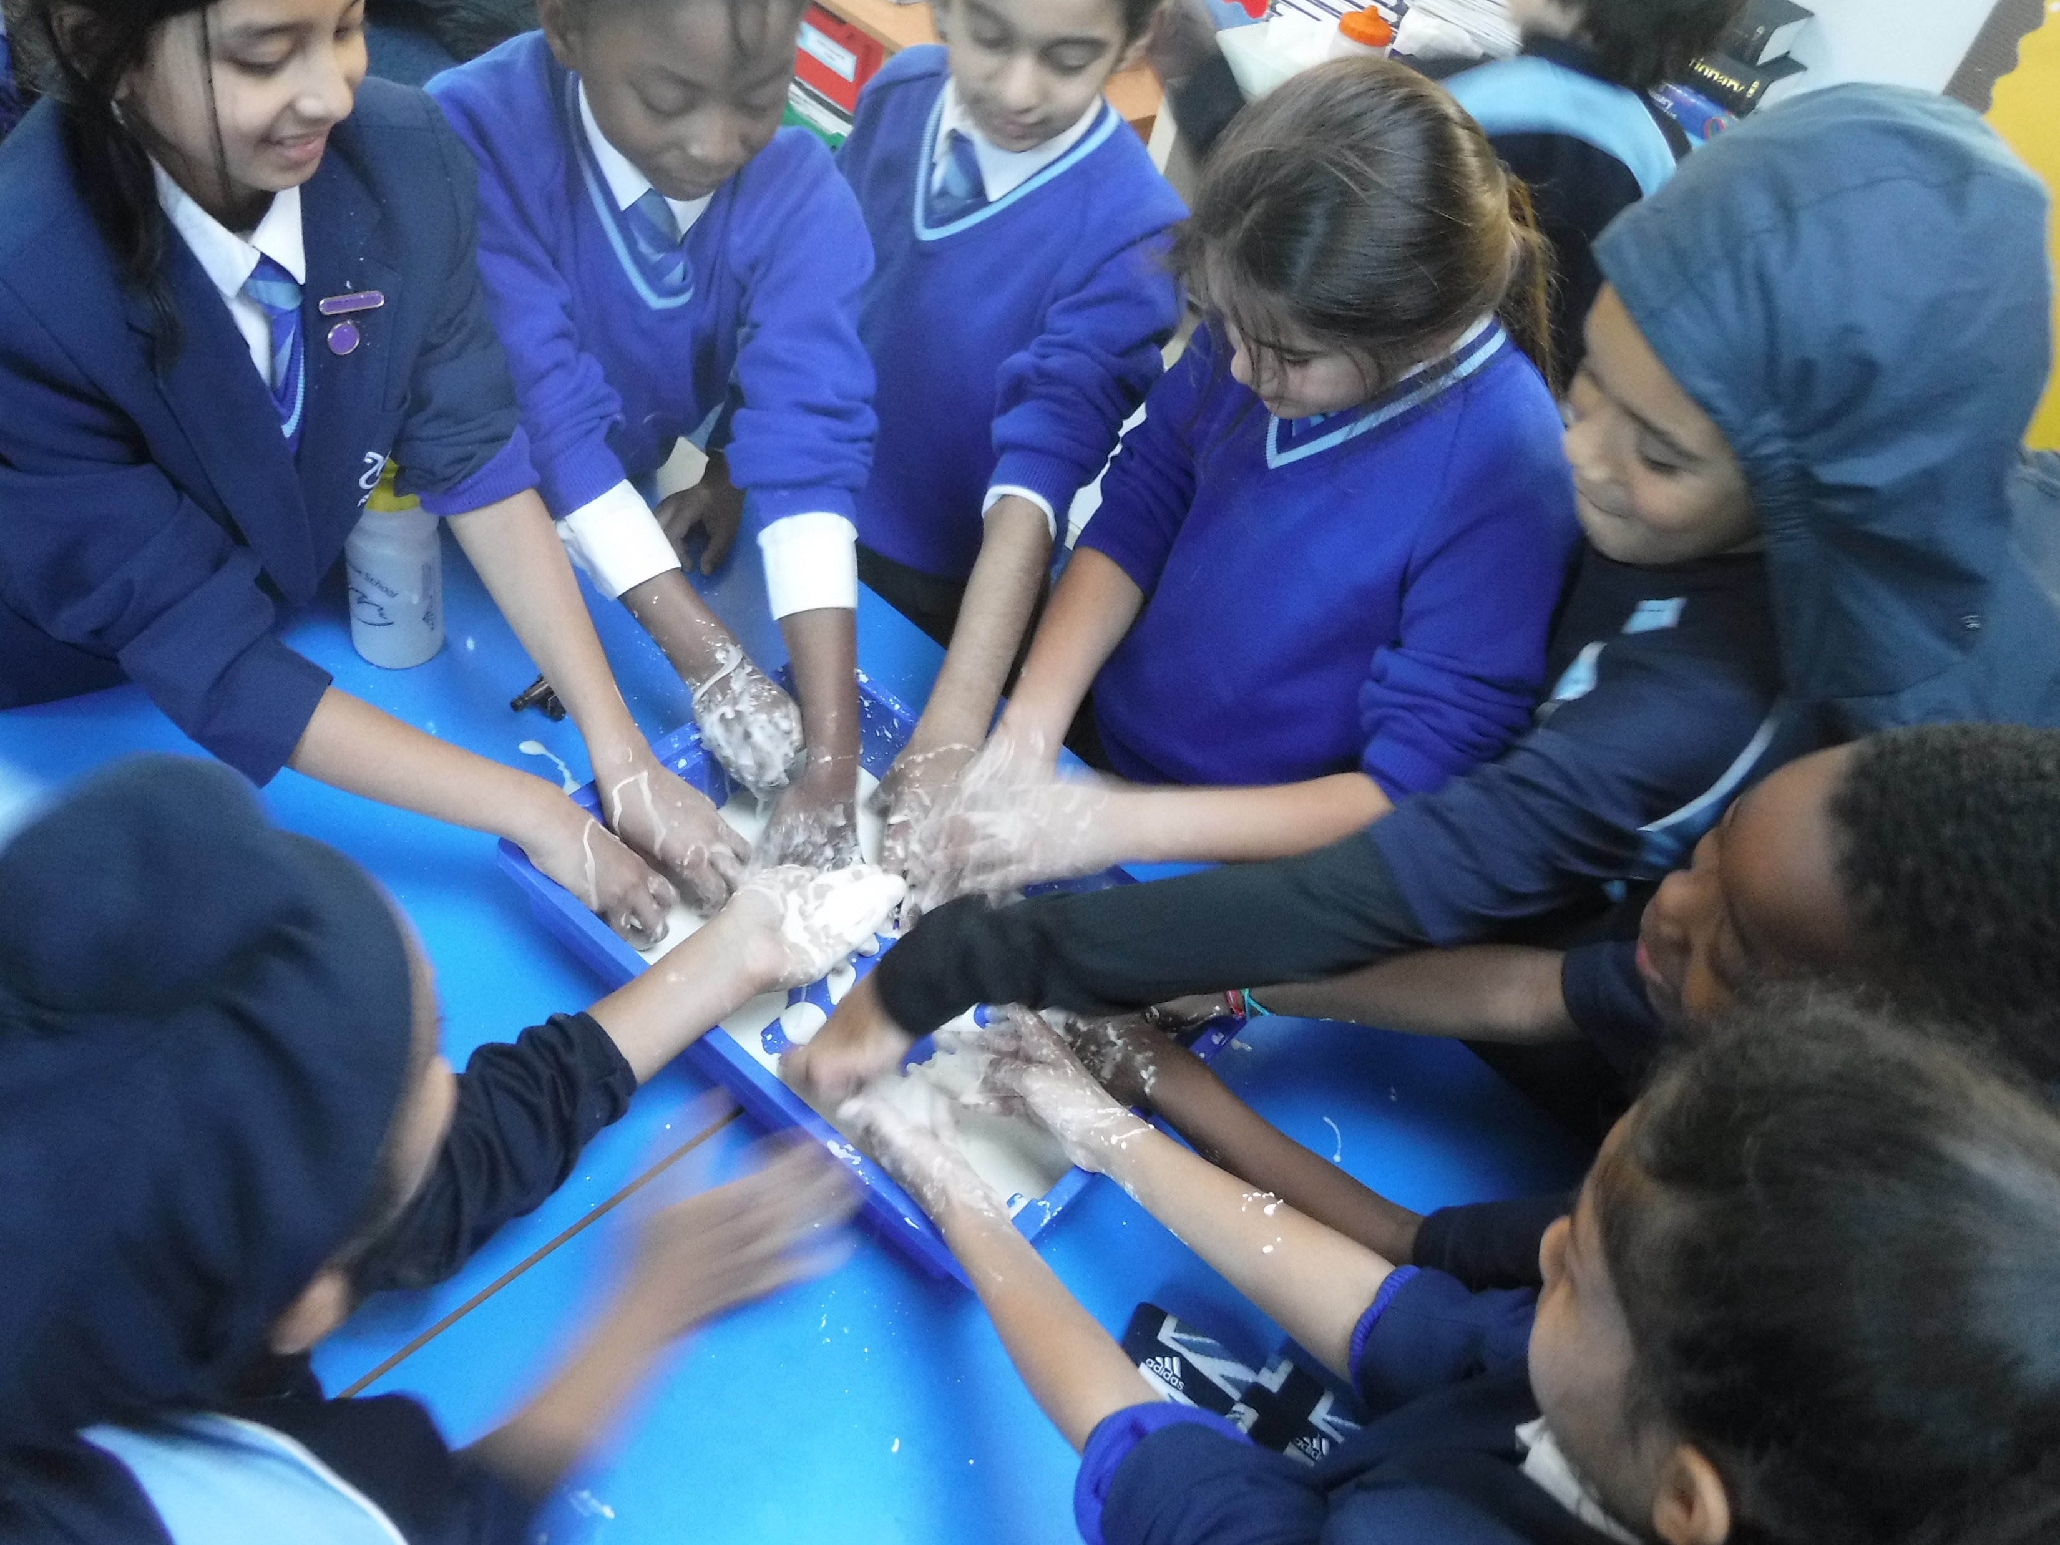
RHSE curriculum at Avon House
Only Year 5 and 6 content considered to be Sex Education
Tailored spiral curriculum
Impact of the position of the lessons in the year. “Puberty should be covered in Health Education and addressed before onset” DfE
Questions and discussions outside of these sessions are inevitable
12

Slide 13
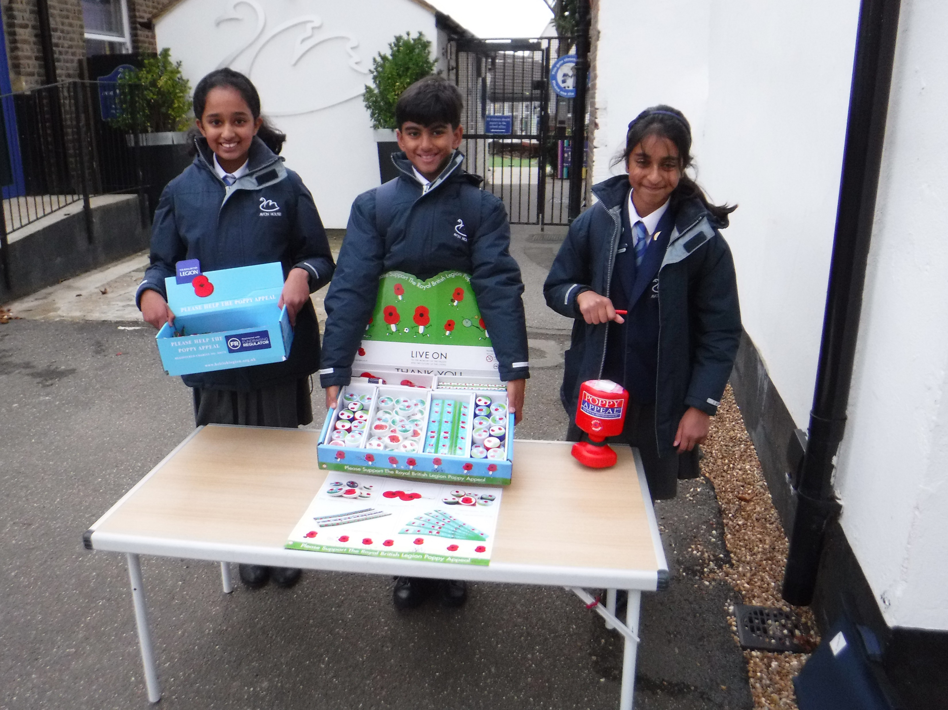
Overview of content at Avon House
Years 1/ 2 Differences between male and female bodies/scientific names
Respecting your body and understanding privacy
(Science, Health, Relationships)
Year 3 Feelings when seeing babies
Changes from baby to adult – lifecycle
Exterior body changes when growing up
(PSHEE, Science, Health)
Year 4 External and internal body changes during puberty
Menstruation
Feelings about body changes
(PSHEE, Science, Health)
Year 5 Puberty and menstruation in more detail
Sexual intercourse leading to conception
(RHSE, Science)
Year 6 Personal and gender identities
Sexual intercourse, conception, development of a baby and birth
(RHSE, Science)
13

Slide 14
The right to withdraw your child from Sex Education
14

Slide 15
Resources…
15

Slide 16
Further information
Parent information leaflet:
(Understanding Relationships and Health Education in your child’s primary school: a guide for parents)
Vocabulary lists (on parent portal)
Book (Brilliant Questions about growing up)
Policies on website
Any Questions?

