Slide 1
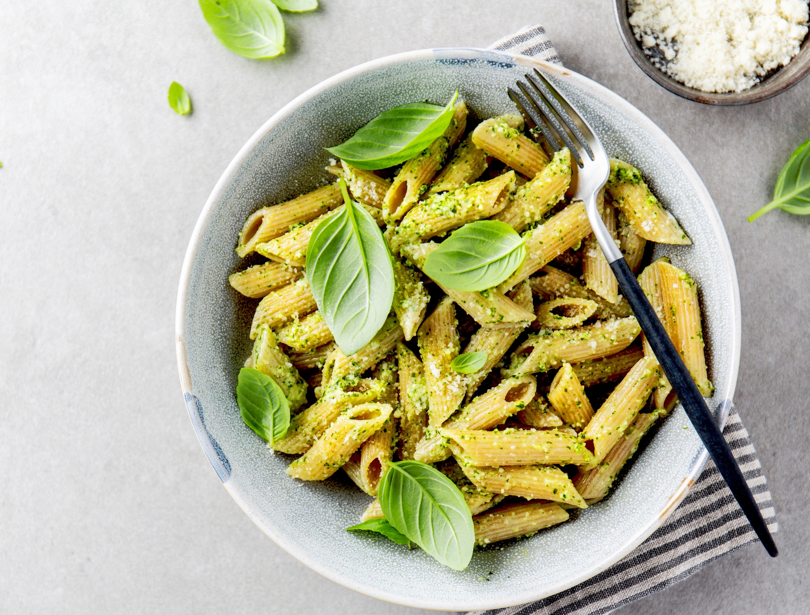
LUNCH MENU – Week 7
Week Commencing 24th Feb 2025
MONDAY | TUESDAY | WEDNESDAY CHINESE NEW YEAR | THURSDAY | FRIDAY
Soup of the day Dish of the day Margaretta Stone baked pizza Halal offer Margaretta stone baked pizza Vegetarian dish of the day Margaretta stone baked pizza Sides Garlic roasted jacket wedges Baby corn & ratatouille Keeping it simple bar Pasta with a choice of homemade sauces Dessert Strawberry mousse Fresh fruit & yoghurt | Soup of the day Dish of the day Jerk chicken Halal offer Jerk spiced chicken Vegetarian dish of the day Caribbean black bean stew Sides Rice Plantain & green beans Keeping it simple bar Baked potato served with baked beans & cheese Dessert Banana cake and cream Fresh fruit & yoghurt | Soup of the day Dish of the day Sweet & sour pork Halal offer Sweet & sour chicken Vegetarian dish of the day Plant based sweet & sour balls Sides Longevity noodles Bok choy and ginger Keeping it simple bar Pasta with a choice of homemade sauces Dessert Choc Bread Pudding with custard Fresh fruit & yoghurt | Soup of the day Dish of the day Beef bolognaise Halal offer Lamb bolognaise Vegetarian dish of the day Lentil bolognaise Sides Homemade garlic focaccia Penne pasta and broccoli Keeping it simple bar Baked potato with a choice of homemade sauces Dessert Jelly and cream Fresh fruit & yoghurt | Soup of the day Dish of the day Lamb Tagine Halal offer Lamb Tagine Vegetarian dish of the day Falafel Tagine Sides Moroccan Rice Peas & Spicy Beans Keeping it simple bar Pasta with a choice of homemade sauces Dessert Sticky Toffee Pudding Fresh fruit & yoghurt
For allergen information, please ask a member of the team also available a salad bar with choice of proteins.

Slide 2
LUNCH MENU – Week 8
Week Commencing 3rd March 2025
MONDAY | TUESDAY | WEDNESDAY | THURSDAY | FRIDAY
Soup of the day Dish of the day Roasted vegetable & spinach bake Halal offer Roasted Vegetable & spinach bake Vegetarian dish of the day Roasted vegetable & spinach bake Sides Charred corn on the cob Green beans Keeping it simple bar Baked potato served with baked beans & cheese Dessert Orange marmalade cake with Cream Fresh fruit & yoghurt | Soup of the day Dish of the day Honey glazed Gammon Halal offer Roasted honey glazed chicken Vegetarian dish of the day Mushroom sweet potato curry Mini naan bread Sides Roast baby potatoes Carrots and cabbage Keeping it simple bar Pasta with a choice of homemade sauces Dessert Bread & Butter Pudding with Custard Fresh fruit & yoghurt | Soup of the day Dish of the day Chicken biryani Halal offer Chicken biryani Vegetarian dish of the day Plant based chicken breast biryani Sides Potato saag aloo Onion bhajis Keeping it simple bar Baked potato served with baked beans & cheese Dessert Lemon Meringue tartlet Fresh fruit & yoghurt | Soup of the day Dish of the day Cumberland sausage with Onion gravy & stuffing Halal offer Chicken Sausage with Onion Gravy & stuffing Vegetarian dish of the day Quorn sausages with onion gravy & stuffing Sides Potato gratin Roasted courgettes Keeping it simple bar Pasta with a choice of homemade sauces Dessert Jelly and cream Fresh fruit & yoghurt | Soup of the day Dish of the day Breaded fish fingers Tartare sauce & lemon wedge Halal offer Breaded fish fingers Tartare sauce & lemon wedge Vegetarian dish of the day Halloumi burger served in a bun Sides Double cooked chips, baked beans and mushy peas Keeping it simple bar Baked potato served with baked beans & cheese Dessert Double chocolate brownie Fresh fruit & yoghurt
For allergen information, please ask a member of the team also available a salad bar with choice of proteins.

Slide 3
LUNCH MENU – Week 9
Week Commencing 10th March 2025
MONDAY | TUESDAY | WEDNESDAY | THURSDAY | FRIDAY
Soup of the day Dish of the day Roasted cauliflower & broccoli masala Halal offer Paneer & broccoli tikka Vegetarian dish of the day Chana masala Sides Steamed rice, mini naan bread Glazed carrots & coriander Keeping it simple bar Baked potato served with baked beans & cheese Dessert Apple & cinnamon pie with custard Fresh fruit & yoghurt | Soup of the day Dish of the day Chicken stir fry Halal offer Chicken & vegetable stir fry Vegetarian dish of the day Chinese tofu stir fry Sides Wheat Noodles Garlic assorted green beans Keeping it simple bar Pasta with a choice of homemade sauces Dessert Frosted carrot cake Fresh fruit & yoghurt | Soup of the day Dish of the day Chorizo & roasted pepper pasta bake Halal offer Tuna & mushroom pasta bake Vegetarian dish of the day Roasted Pepper and garlic pasta bake Sides Glazed carrots Broccoli florets Keeping it simple bar Baked potato served with baked beans & cheese Dessert Jelly & cream Fresh fruit & yoghurt | Soup of the day Dish of the day Mexican Beef Sour cream / guacamole Salsa Halal offer Mexican Lamb Sour cream / guacamole Salsa Vegetarian dish of the day Mexican bean stew Sour cream / guacamole Salsa Sides Crispy tacos Cauliflower Keeping it simple bar Pasta with a choice of homemade sauces Dessert Pear & berry crumble with cream Fresh fruit & yoghurt | Soup of the day Dish of the day Breaded fish fingers Tartare sauce & lemon wedge Halal offer Breaded fish fingers Tartare sauce & lemon wedge Vegetarian dish of the day Plant based breaded fingers Tartare sauce & lemon wedge Sides Double cooked chips Peas & sweetcorn Keeping it simple bar Baked potato served with baked beans & cheese Dessert Fruit Flapjack Fresh fruit & yoghurt
For allergen information, please ask a member of the team also available a salad bar with choice of proteins.

