Slide 1
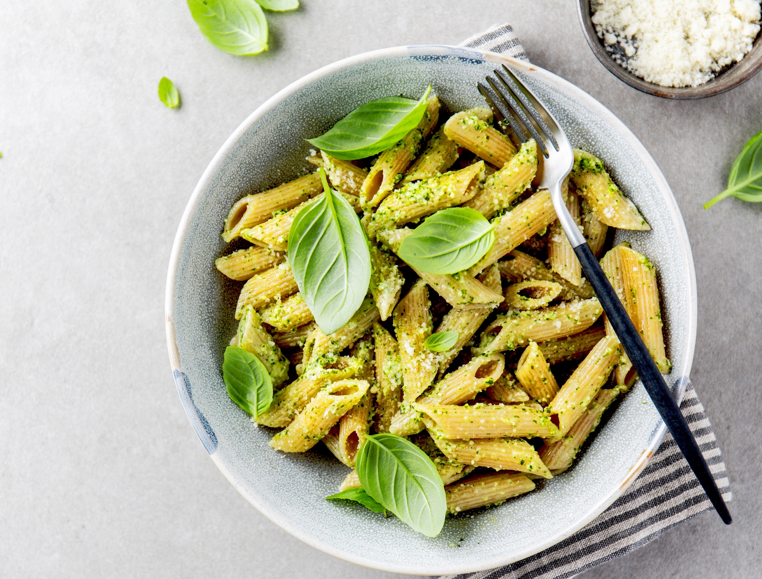
LUNCH MENU
Week Commencing 17th March 2025
MONDAY | TUESDAY | WEDNESDAY SPANISH LUNCH | THURSDAY | FRIDAY
Soup of the day Dish of the day Margaretta Stone baked pizza Halal offer Margaretta stone baked pizza Vegetarian dish of the day Margaretta stone baked pizza Sides Garlic roasted jacket wedges Baby corn & ratatouille Keeping it simple bar Pasta with a choice of homemade sauces Dessert Strawberry mousse Fresh fruit & yoghurt | Soup of the day Dish of the day Jerk chicken Halal offer Jerk spiced chicken Vegetarian dish of the day Caribbean black bean stew Sides Rice Plantain & green beans Keeping it simple bar Baked potato served with baked beans & cheese Dessert Banana cake and cream Fresh fruit & yoghurt | Soup of the day Dish of the day Pollo al ajillo (Garlic & thyme roast chicken) Halal offer Pollo al ajillo (Garlic & thyme roast chicken) Vegetarian dish of the day Tortilla de patatas (Spanish omelette) Sides Patas bravas (paprika roasted potatoes) Verdure Arrostite (Roasted Vegetables) Keeping it simple bar Pasta with a choice of homemade sauces Dessert Tiramisù al Limone (Lemon Tiramisu) Fresh fruit & yoghurt | Soup of the day Dish of the day Beef bolognaise Halal offer Lamb bolognaise Vegetarian dish of the day Lentil bolognaise Sides Homemade garlic focaccia Penne pasta and broccoli Keeping it simple bar Baked potato with a choice of homemade sauces Dessert Jelly and cream Fresh fruit & yoghurt | Soup of the day Dish of the day Lamb Tagine Halal offer Lamb Tagine Vegetarian dish of the day Falafel Tagine Sides Moroccan Rice Peas & Spicy Beans Keeping it simple bar Pasta with a choice of homemade sauces Dessert Sticky Toffee Pudding Fresh fruit & yoghurt
For allergen information, please ask a member of the team also available a salad bar with choice of proteins.

Slide 2
LUNCH MENU
Week Commencing 24th March 2025
MONDAY | TUESDAY | WEDNESDAY | THURSDAY | FRIDAY
Soup of the day Dish of the day Roasted cauliflower & broccoli masala Halal offer Paneer & broccoli tikka Vegetarian dish of the day Chana masala Sides Steamed rice, mini naan bread Glazed carrots & coriander Keeping it simple bar Baked potato served with baked beans & cheese Dessert Apple & cinnamon pie with custard Fresh fruit & yoghurt | Soup of the day Dish of the day Chicken stir fry Halal offer Chicken & vegetable stir fry Vegetarian dish of the day Chinese tofu stir fry Sides Wheat Noodles Garlic assorted green beans Keeping it simple bar Pasta with a choice of homemade sauces Dessert Frosted carrot cake Fresh fruit & yoghurt | Soup of the day Dish of the day Chorizo & roasted pepper pasta bake Halal offer Tuna & mushroom pasta bake Vegetarian dish of the day Roasted Pepper and garlic pasta bake Sides Glazed carrots Broccoli florets Keeping it simple bar Baked potato served with baked beans & cheese Dessert Jelly & cream Fresh fruit & yoghurt | Soup of the day Dish of the day Mexican Beef Sour cream / guacamole Salsa Halal offer Mexican Lamb Sour cream / guacamole Salsa Vegetarian dish of the day Mexican bean stew Sour cream / guacamole Salsa Sides Crispy tacos Cauliflower Keeping it simple bar Pasta with a choice of homemade sauces Dessert Pear & berry crumble with cream Fresh fruit & yoghurt | Soup of the day Dish of the day Roast Lamb with Yorkshire pudding Halal offer Roast lamb with Yorkshire pudding Vegetarian dish of the day Roast Plant Base Strips with Yorkshires Pudding Sides Roast Potatoes Parsnips & Carrots Keeping it simple bar Baked potato served with baked beans & cheese Dessert Hot Cross Buns Fresh fruit & yoghurt
For allergen information, please ask a member of the team also available a salad bar with choice of proteins.

